Slide 1

Designing And Implementation Of Dynamic web Application Using Java
By
Tammam Awad
Reem Yaseen
Supervisor
Dr. Mohamed-Alkhateeb

Slide 2
Introduction
Driven by the explosive growth of information available on the Internet, intelligent information access has become a central research area in computer science. The 20th century is commonly characterized as “The Information Age”, and the sheer amount of information readily available today has created novel challenges. Numerous intelligent information agents software tools that provide personalized assistance for users navigating large information spaces -- have been described in the literature and deployed on the World-Wide-Web However, the need for intelligent information agents is not limited to web-based applications, as we are currently witnessing an increasing trend towards “ubiquitous information access”.

Slide 3
Objectives
Provide a brief overlook of the importance and growth of News System in the latest couple of years.
Provide a clear categorization of the target system according to Customer.
Provide a fully functional system analysis of the target system
Provide an adequate explanation of the implemented techniques used to achieve the final system.
Provide a brief overlook of web service using JAX-RPC.
Provide a brief overlook of web client using JSP .
Provide a brief overlook of client using J2SE.
Provide a brief overlook of mobile client using j2me.

Slide 4
Servlet And JSP
Introduction:
The servlet technology is the foundation of web application development using the Java programming language. It is one of the most important Java technologies, and it is the underlying technology for another popular Java technology for web application development: JavaServer Pages (JSP)

Slide 5
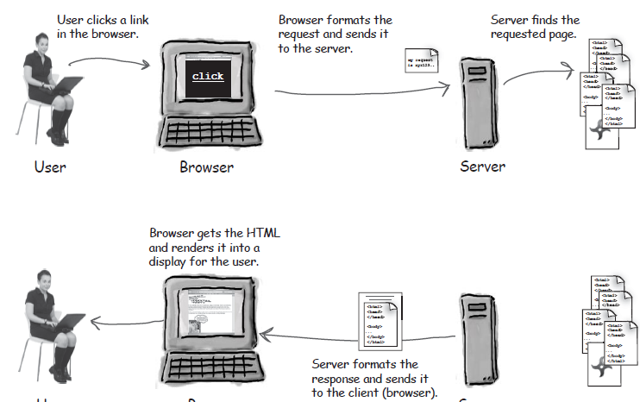
Servlet And JSP

Slide 6

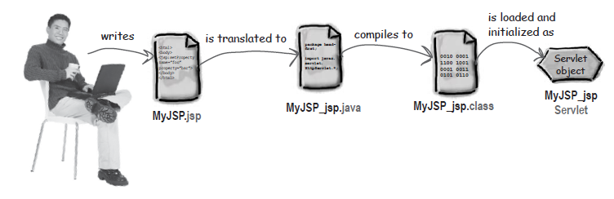
Servlet And JSP

Slide 7
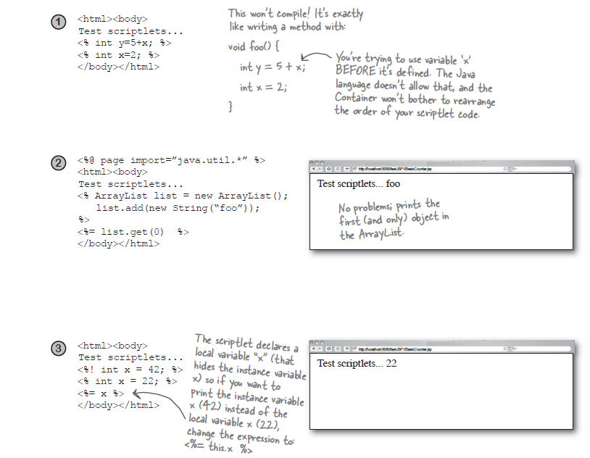

Slide 8
Web Service
The most significant aspect of Web services is that every software and hardware company in the world has positioned itself around these technologies for interoperability. No single technological advancement will have as great an impact on the way systems are developed as Web services.
Web services allow systems to communicate with each other using standard Internet technologies. Systems that have to communicate with other systems use communication protocols and the data formats that both systems understand. Developers use technologies such as CORBA, RMI, or DCOM most often. The principal problem with these communication technologies is that not every platform supports them. Developers must create gateways to convert an unsupported protocol and data format into one that the target platform understands.

Slide 9
JAX-RPC
JAX-RPC was designed to provide a simple way for developers to create web services and web service clients using techniques that are not very different from those used in nondistributed Java programming. Programming with JAX-RPC is very similar to using RMI to create a distributed application, in the sense that client code appears to be making ordinary method calls on local objects. In reality, however, the infrastructure handles these calls by converting them to messages that are sent over a network to the server, where they cause a local call to be made on the actual method implementation. The results of this call are used to create a reply message that is sent back the client, where they are extracted and presented as return values from the client application's method call.

Slide 10
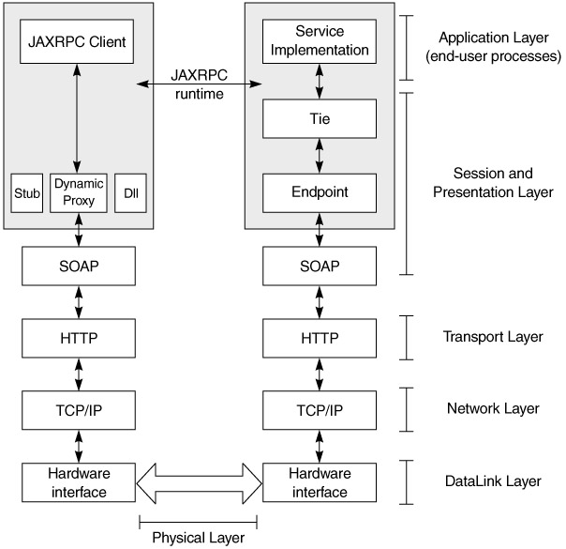
JAX-RPC

Slide 11
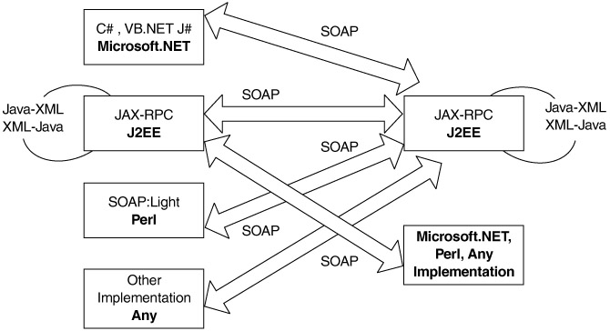

Slide 12
J2ME
Mobile Client

Slide 13
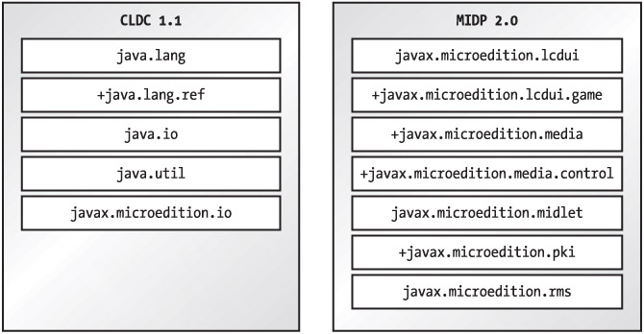

Slide 14
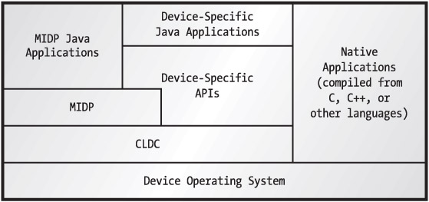
MIDP software components

Slide 15
System Analysis And Design

Slide 16
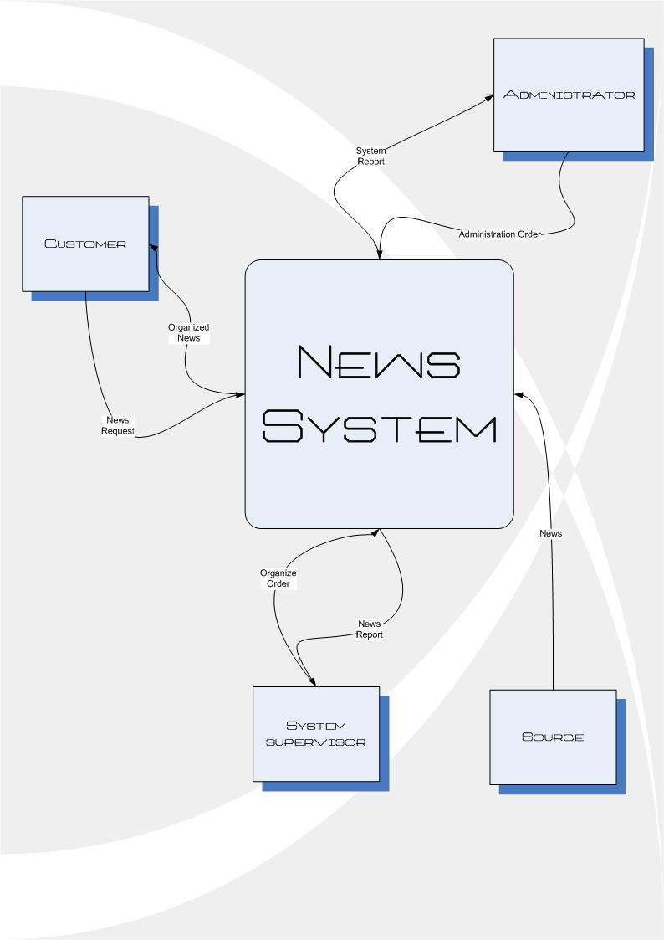
DFD Context Diagram

Slide 17
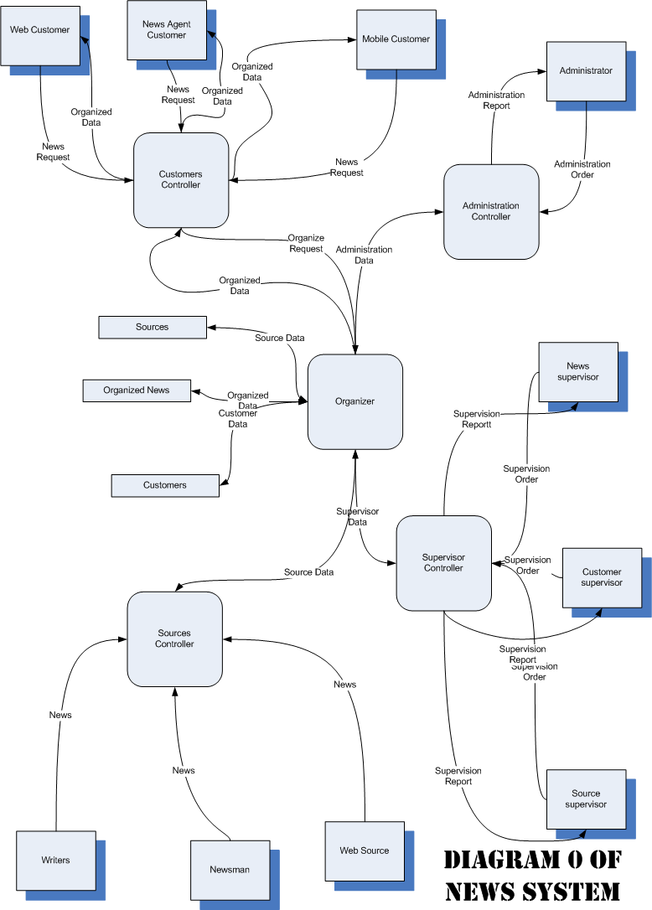

Slide 18
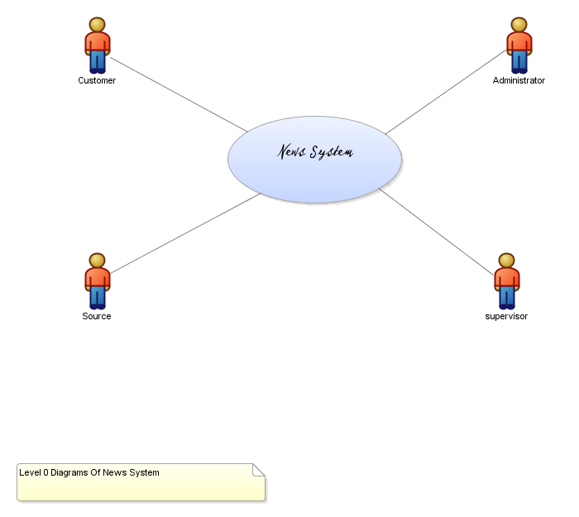

Slide 19
